Slide 1



Slide 2
What is ES6? (JAVA SCRIPT E6)
ES6 is an acronym of ECMAScript 6 and also known as ECMAScript 2015.
ES6 or ECMAScript6 is a scripting language specification which is standardized by ECMAScript International.
It is used by the applications to enable client-side scripting.
This specification governs some languages such as JavaScript, ActionScript, and Jscript.
ES6 allows you to make the code more modern and readable.
By using ES6 features, we write less and do more, so the term 'Write less, do more' suits ES6.
ES6 introduces you many great features such as scope variable, arrow functions, template strings, class destructions, modules, etc.
ES6 was created to standardize JavaScript to help several independent implementations.

Slide 3
ECMA Script6’s New features −
Support for constants
Block Scope
Arrow Functions
Extended Parameter Handling
Template Literals
Extended Literals
Enhanced Object Properties
De-structuring Assignment
Modules
Classes
Iterators
Generators
Collections
New built in methods for various classes
Promises

Slide 4
const:
ES6 gives a new way to declare a constant using the const keyword.
The keyword const creates a read-only reference to the value. There are some properties of the const that are as follows:
Properties:
It cannot be reassigned a value.
It is block scoped.
A constant cannot be re-declared.
Constants must be initialized at the time of declaration.
For example:
const y=100
y=200 // It will result in an error
Output:
TypeError: Assignment to constant variable.
It will throw an error because the constant variables are immutable and cannot be reassigned a value.

Slide 5
Constants
Support for constants (also known as "immutable variables"), i.e., variables which cannot be re-assigned new content.
This makes the variable itself immutable, not its assigned content (for instance, in case the content is an object, this means the object itself can still be altered).
const PI = 3.141593

Slide 6
Extended Parameter Handling
ES6 supports is the extended parameter handling.
Default parameter values and optional parameters
Default parameters allow your functions to have optional arguments without needing to check arguments.length or check for undefined.

Slide 7
let greet = (msg = 'hello', name = 'world') =>
{
console.log(msg,name);
}
greet();
greet('hey’);
Output:
hello world
hey world

Slide 8
function say(message='Hi') {
console.log(message);
}
say(); // 'Hi'
say('Hello') // 'Hello'
The default value of the message paramater in the say() function is 'Hi'.
In JavaScript, default function parameters allow you to initialize named parameters with default values if no values or undefined are passed into the function.

Slide 9
Arguments vs. Parameters
Sometimes, you can use the term argument and parameter interchangeably.
However, by definition, parameters are what you specify in the function declaration whereas the arguments are what you pass to the function.
Consider the following add() function:
function add(x, y) {
return x + y;
}
add(100,200);
In this example, the x and y are the parameters of the add() function, and the values passed to the add() function 100 and 200 are the arguments.

Slide 10
Setting JavaScript default parameters for a function
In JavaScript, a parameter has a default value of undefined.
It means that if you don’t pass the arguments into the function, its parameters will have the default values of undefined.
See the following example:
function say(message) {
console.log(message);
}
say(); // undefined
The say() function takes the message parameter.
Because we didn’t pass any argument into the say() function, the value of the message parameter is undefined.

Slide 11
A typical way for achieving this is to test parameter value and assign a default value if it is undefined using a ternary operator:
function say(message) {
message = typeof message !== 'undefined' ? message : 'Hi';
console.log(message);
}
say(); // 'Hi'

Slide 12
Therefore, the default value of the message argument is undefined.
Inside the function, we reassigned the message variable the Hi string.
ES6 provides you with an easier way to set the default values for the function parameters like this:
function fn(param1=default1, param2=default2,..)
{
}

Slide 13
In the syntax above, you use the assignment operator (=) and the default value after the parameter name to set a default value for that parameter. For example:
function say(message='Hi') {
console.log(message);
}
say(); // 'Hi'
say(undefined); // 'Hi'
say('Hello'); // 'Hello'
Code language: JavaScript (javascript)

Slide 14
In the first function call, we didn’t pass any argument into the say() function, therefore message parameter took the default value 'Hi’.
In the second function call, we passed the undefined into the say() function, hence the message parameter also took the default value 'Hi'.
In the third function call, we passed the 'Hello' string into the say() function, therefore message parameter took the string 'Hello' as the default value.

Slide 15
function date(d = today()) {
console.log(d);
}
function today() {
return (new Date()).toLocaleDateString("en-US");
}
date();
The date() function takes one parameter whose default value is the returned value of the today() function.
The today() function returns today’s date in a specified string format.
When we declared the date() function, the today() function has not yet evaluated until we called the date() function.

Slide 16
3) Using other parameters in default values
You can assign a parameter a default value that references to other default parameters as shown in the following example:
function add(x = 1, y = x, z = x + y) {
return x + y + z;
}
console.log(add()); // 4

Slide 17
function add(x, y = 1, z = 2) {
console.log( arguments.length );
return x + y + z;
}
add();
add(10); // 1
add(10, 20); // 2
add(10, 20, 30); // 3

Slide 18
ES6 Rest Parameter
ES6 has some great features that make working with function parameters and arrays extremely easy by using spread operator and rest parameters.
The rest parameter is introduced in ECMAScript 2015 or ES6, which improves the ability to handle parameters.
The rest parameter allows us to represent an indefinite number of arguments as an array.
By using the rest parameter, a function can be called with any number of arguments.
The rest parameter is prefixed with three dots (...).
Although the syntax of the rest parameter is similar to the spread operator, it is entirely opposite from the spread operator.
The rest parameter has to be the last argument because it is used to collect all of the remaining elements into an array.

Slide 19
Syntax
function fun(a, b, ...theArgs) {
// statements
}
Example
function show(...args) {
let sum = 0;
for (let i of args) {
sum += i;
}
console.log("Sum = "+sum);
}
show(10, 20, 30);
show(10, 20, 30,40);
Output
Sum = 60
Sum = 100

Slide 20
Rest parameter
Handling a function with a variable number of arguments is always tricky in JavaScript.
Rest parameters (…), indicated by three consecutive dot characters, allow your functions to have a variable number of arguments without using the arguments object.
The rest parameter is an instance of Array, so all array methods work.

Slide 21
function f(x, ...y) {
console.log(y);
// y is an Array
return x * y.length;
}
console.log(f(3, 'hello', true) === 6);
Running the preceding code produces the following result:
["hello", true]
true
You can have as many regular arguments as you’d like, but the rest parameter must always be the last.

Slide 22
ES6 Spread Operator
ES6 introduced a new operator referred to as a spread operator, which consists of three dots (...).
It allows an iterable to expand in places where more than zero arguments are expected.
It gives us the privilege to obtain the parameters from an array.
Spread operator syntax is similar to the rest parameter, but it is entirely opposite of it.
Let's understand the syntax of the spread operator.
Syntax
var variablename1 = [...value];
The three dots (...) in the above syntax are the spread operator, which targets the entire values in the particular variable.

Slide 23

Spread Operator
The spread operator “spreads” the values in an iterable (arrays, strings) across zero or more arguments or elements.
The spread operator takes an array (or any iterable) and spreads it values. Let’s take a look at how it works:
const array1=[1,2,3,4];
const array2=[5,6,7,8];
array3=[...array1,...array2]
console.log(array3)

Slide 24
The spread operator can also be used in a function call.
function mysum(num1,num2,num3)
{
console.log(num1+num2+num3)
}
let num=[1,2,3,4]
mysum(...num)
O/P
6
The spread operator takes the array of parameters and spreads them across the arguments in the function call.
But what if we need our function to be able to work with an unknown number of parameters? That’s where the rest parameter comes in.

Slide 25
var params = [ "hello", true, 7 ]
var other = [ 1, 2, ...params ] // [ 1, 2, "hello", true, 7 ]
function f (x, y, ...a) {
return (x + y) * a.length
}
f(1, 2, ...params) === 9
var str = "foo"
var chars = [ ...str ] // [ "f", "o", "o" ]

Slide 26
Spread Operator and Array Manipulation
Here, we are going to see how we can manipulate an array by using the spread operator.
Constructing array literal
When we construct an array using the literal form, the spread operator allows us to insert another array within an initialized array.
Example
let colors = ['Red', 'Yellow'];
let newColors = [...colors, 'Violet', 'Orange', 'Green'];
console.log(newColors);
Output
[ 'Red', 'Yellow', 'Violet', 'Orange', 'Green' ]

Slide 27
Concatenating arrays
Spread operator can also be used to concatenate two or more arrays.
Example
let colors = ['Red', 'Yellow'];
let newColors = [...colors, 'Violet', 'Orange', 'Green'];
console.log(newColors);
Output
[ 'Red', 'Yellow', 'Violet', 'Orange', 'Green' ]

Slide 28
Copying an array
We can also copy the instance of an array by using the spread operator.
Example
let colors = ['Red', 'Yellow'];
let newColors = [...colors];
console.log(newColors);
Output
[ 'Red', 'Yellow' ]

Slide 29
Spread operator and Strings
Let's see how the spread operator spreads the strings.
The illustration for the same is given below.
Example
Here, we have constructed an array str from individual strings.
let str = ['A', ...'EIO', 'U'];
console.log(str);
In the above example, we have applied the spread operator to the string 'EIO’.
It spreads out each specific character of the 'EIO' string into individual characters.
We will get the following output after the execution of the above code.
Output
[ 'A', 'E', 'I', 'O', 'U' ]

Slide 30
Spread operator
The spread operator is like the reverse of rest parameters. It allows you to expand an array into multiple formal parameters.
function add(a, b)
{
return a + b;
}
let nums = [5, 4];
console.log(add(...nums));
Running the preceding code produces the following result:
9

Slide 31
function add(a, b) {
return a + b;
}
let nums = [4];
console.log(add(5, ...nums));

Slide 32
let a = [2, 3, 4];
let b = [1, ...a, 5];
console.log(b);
Running the preceding code produces the following output:
[1, 2, 3, 4, 5]

Slide 33
JavaScript rest parameters examples
See the following example:
function sum(...args) {
let total = 0;
for (const a of args) {
total += a;
}
return total;
}
sum(1, 2, 3);
The output of the script is:
6

Slide 34
JavaScript rest parameters and arrow function
An arrow function does not have the arguments object.
Therefore, if you want to pass a number of arguments to the arrow function, you must use the rest parameters.
See the following example:
const combine = (...args) => {
return args.reduce(function (prev, curr) {
return prev + " " + curr;
});
};
let message = combine("JavaScript", "Rest", "Parameters"); // =>
console.log(message); // JavaScript Rest Parameters

Slide 35
Output:
JavaScript Rest Parameters
The combine() function is an arrow that takes an indefinite number of arguments and concatenates these arguments.
JavaScript rest parameter in a dynamic function
JavaScript allows you to create dynamic functions through the Function constructor.
And it is possible to use the rest parameter in a dynamic function. Here is an example:
var showNumbers = new Function('...numbers', 'console.log(numbers)');
showNumbers(1, 2, 3);
Output:
[ 1, 2, 3 ]

Slide 36
Introduction to the JavaScript spread operator
ES6 provides a new operator called spread operator that consists of three dots (...).
The spread operator allows you to spread out elements of an iterable object such as an array,a map, or a set. For example:
const odd = [1,3,5];
const combined = [2,4,6, ...odd];
console.log(combined);
Code language: JavaScript (javascript)
Output:
[ 2, 4, 6, 1, 3, 5 ]
In this example, the three dots ( ...) located in front of the odd array is the spread operator.
The spread operator unpacks the elements of the odd array.

Slide 37
ES6 also has the three dots ( ...) which is a rest parameter that collects all remaining arguments of a function into an array.
function f(a, b, ...args) {
console.log(args);
}
f(1, 2, 3, 4, 5);
Code language: JavaScript (javascript)
Output:
[ 3, 4, 5 ]

Slide 38
In this example, the rest parameter (...) collects the arguments 3,4 and 5 into an array args.
So the three dots ( ...) represent both the spread operator and the rest parameter.
Here are the main differences:
The spread operator unpacks elements.
The rest parameter packs elements into an array.
The rest parameters must be the last arguments of a function. However, the spread operator can be anywhere:
const odd = [1,3,5];
const combined = [...odd, 2,4,6];
console.log(combined);
Output:
[ 1, 3, 5, 2, 4, 6 ]
The spread operator spreads out the elements of the array so a = 1 and b = 2 in this case.

Slide 39
Array’s push() method example
Sometimes, a function may accept an indefinite number of arguments. Filling arguments from an array is not convenient.
For example, the push() method of an array object allows you to add one or more elements to an array.
If you want to pass an array to the push() method, you need to use apply() method as follows:
var rivers = ['Nile', 'Ganges', 'Yangte'];
var moreRivers = ['Danube', 'Amazon'];
Array.prototype.push.apply(rivers, moreRivers);
console.log(rivers);
rivers.push(...moreRivers);

Slide 40
JavaScript spread operator and array manipulation
1) Constructing array literal
The spread operator allows you to insert another array into the initialized array when you construct an array using the literal form.
See the following example:
let initialChars = ['A', 'B'];
let chars = [...initialChars, 'C', 'D'];
console.log(chars); // ["A", "B", "C", "D"]

Slide 41
2) Concatenating arrays
Also, you can use the spread operator to concatenate two or more arrays:
let numbers = [1, 2];
let moreNumbers = [3, 4];
let allNumbers = [...numbers, ...moreNumbers];
console.log(allNumbers); // [1, 2, 3, 4]
3) Copying an array
In addition, you can copy an array instance by using the spread operator:
let scores = [80, 70, 90];
let copiedScores = [...scores];
console.log(copiedScores); // [80, 70, 90]

Slide 42
JavaScript spread operator and strings
Consider the following example:
let chars = ['A', ...'BC', 'D'];
console.log(chars); // ["A", "B", "C", "D"]

Slide 43
Summary
The spread operator is denoted by three dots (…).
The spread operator unpacks elements of iterable objects such as arrays, sets, and maps into a list.
The rest paramter is also denoted by three dots (…).
However, it packs the remaining arguments of a function into an array.
The spread operator can be used to clone an iterable object or merge iterable objects into one.
The spread operator allows us to spread the value of an array (or any iterable) across zero or more arguments in a function or elements in an array (or any iterable).
The rest parameter allows us to pass an indefinite number of parameters to a function and access them in an array.

Slide 44
JavaScript Template Literals:
In ES6, you create a template literal by wrapping your text in backticks (`) as follows:
let simple = `This is a template literal`;
and you get the following features:
A multiline string: a string that can span multiple lines.
String formatting: the ability to substitute part of the string for the values of variables or expressions.
This feature is also called string interpolation.
HTML escaping: the ability to transform a string so that it is safe to include in HTML.

Slide 45
The basic syntax of JavaScript template literals
As mentioned earlier, instead of using the single quotes or double quotes, a template literal uses backticks as shown in the following example:
let str = `Template literal in ES6`;
console.log(str);// Template literal in ES6
console.log(str.length); // 23
console.log(typeof str);// string

Slide 46
Back-Tics Syntax
Template Literals use back-ticks (``) rather than the quotes ("") to define a string:
Example
let text = `Hello World!`;
Quotes Inside Strings
With template literals, you can use both single and double quotes inside a string:
Example
let text = `He's often called "Johnny"`;

Slide 47
Multiline Strings
Template literals allows multiline strings:
Example
let text =
`The quick
brown fox
jumps over
the lazy dog`;

Slide 48
Interpolation
Template literals provide an easy way to interpolate variables and expressions into strings.
The method is called string interpolation.
The syntax is:
${...}
Variable Substitutions:
Template literals allow variables in strings:
Example
let firstName = "John";
let lastName = "Doe";
let text = `Welcome ${firstName}, ${lastName}!`;

Slide 49
Expression Substitution
Template literals allow expressions in strings:
Example
let price = 10;
let VAT = 0.25;
let total = `Total: ${(price * (1 + VAT)).toFixed(2)}`;

Slide 50
Template literals (Template strings)
Template literals are literals delimited with backticks (`), allowing embedded expressions called substitutions.
Untagged template literals result in strings, which makes them useful for string interpolation (and multiline strings, since unescaped newlines are allowed).
Tagged template literals call a function (the tag function) with an array of any text segments from the literal followed by arguments with the values of any substitutions, which is useful for DSLs.
Template literals are sometimes informally called template strings, but they aren't string literals and can't be used everywhere a string literal can be used.
Also, a tagged template literal may not result in a string; it's up to the tag function what it creates (if anything).

Slide 51
Syntax
// Untagged, these create strings:
`string text`
`string text line 1
string text line 2`
`string text ${expression} string text`
// Tagged, this calls the function "example" with the template as the
// first argument and substitution values as subsequent arguments:
example`string text ${expression} string text`

Slide 52
Multi-line strings
Any newline characters inserted in the source are part of the template literal.
Using normal strings, you would have to use the following syntax in order to get multi-line strings:
console.log('string text line 1\n' +
'string text line 2');
// "string text line 1
// string text line 2"

Slide 53
Using template literals, you can do the same like this:
console.log(`string text line 1
string text line 2`);
// "string text line 1
// string text line 2“
Expression interpolation
In order to embed expressions within normal strings, you would use the following syntax:
let a = 5;
let b = 10;
console.log('Fifteen is ' + (a + b) + ' and\nnot ' + (2 * a + b) + '.');
// "Fifteen is 15 and
// not 20."

Slide 54
Expression interpolation
In order to embed expressions within normal strings, you would use the following syntax:
let a = 5;
let b = 10;
console.log('Fifteen is ' + (a + b) + ' and\nnot ' + (2 * a + b) + '.');
// "Fifteen is 15 and
// not 20."

Slide 55
Now, with template literals, you are able to make use of the syntactic sugar, making substitutions like this more readable:
let a = 5;
let b = 10;
console.log(`Fifteen is ${a + b} and
not ${2 * a + b}.`);
// "Fifteen is 15 and
// not 20."

Slide 56
Now, with template literals, you are able to make use of the syntactic sugar, making substitutions like this more readable:
let a = 5;
let b = 10;
console.log(`Fifteen is ${a + b} and
not ${2 * a + b}.`);
// "Fifteen is 15 and
// not 20."

Slide 57
let name = 'Computer',
status = 'On';
let machine = {
name,
status
};

Slide 58
Getting Literal With ES6 Template Strings :
Strings in JavaScript have been historically limited, lacking the capabilities one might expect coming from languages like Python or Ruby.
ES6 Template Strings (available in Chrome 41+), fundamentally change that. They introduce a way to define strings with domain-specific languages (DSLs), bringing better:
String interpolation
Embedded expressions
Multiline strings without hacks
String formatting
String tagging for safe HTML escaping, localization and more.

Slide 59
Syntax
Template Strings use back-ticks (``) rather than the single or double quotes we're used to with regular strings. A template string could thus be written as follows:
var greeting = `Yo World!`;
String Substitution
One of their first real benefits is string substitution.
Substitution allows us to take any valid JavaScript expression (including say, the addition of variables) and inside a Template Literal, the result will be output as part of the same string.
Template Strings can contain placeholders for string substitution using the ${ } syntax, as demonstrated below:
// Simple string substitution
var name = "Brendan";
console.log(`Yo, ${name}!`);
// => "Yo, Brendan!"

Slide 60
JavaScript Promise Object:
A JavaScript Promise object contains both the producing code and calls to the consuming code.
A Promise is an object representing the eventual completion or failure of an asynchronous operation.(non blocking).
Producing code" is code that can take some time
"Consuming code" is code that must wait for the result
A Promise is a JavaScript object that links producing code and consuming code

Slide 61
Promise
The Promise object represents the eventual completion (or failure) of an asynchronous operation and its resulting value.
A Promise is a proxy for a value not necessarily known when the promise is created.
It allows you to associate handlers with an asynchronous action's eventual success value or failure reason.
This lets asynchronous methods return values like synchronous methods: instead of immediately returning the final value, the asynchronous method returns a promise to supply the value at some point in the future.

Slide 62
Promise Syntax
let myPromise = new Promise(function(myResolve, myReject) {
// "Producing Code" (May take some time)
myResolve(); // when successful
myReject(); // when error
});
// "Consuming Code" (Must wait for a fulfilled Promise)
myPromise.then(
function(value) { /* code if successful */ },
function(error) { /* code if some error */ }
);

Slide 63
A “producing code” that does something and takes time. For instance, some code that loads the data over a network. That’s a “singer”.
A “consuming code” that wants the result of the “producing code” once it’s ready.
Many functions may need that result. These are the “fans”.
A promise is a special JavaScript object that links the “producing code” and the “consuming code” together. In terms of our analogy: this is the “subscription list”.
The “producing code” takes whatever time it needs to produce the promised result, and the “promise” makes that result available to all of the subscribed code when it’s ready.

Slide 64
The constructor syntax for a promise object is:
let promise = new Promise(function(resolve, reject) {
// executor (the producing code, "singer")
});
The function passed to new Promise is called the executor. When new Promise is created, the executor runs automatically.
It contains the producing code which should eventually produce the result. In terms of the analogy above: the executor is the “singer”.
Its arguments resolve and reject are callbacks provided by JavaScript itself.
Our code is only inside the executor.

Slide 65
When the executor obtains the result, be it soon or late, doesn’t matter, it should call one of these callbacks:
resolve(value) — if the job is finished successfully, with result value.
reject(error) — if an error has occurred, error is the error object.

Slide 66
summary:
The executor runs automatically and attempts to perform a job. When it is finished with the attempt, it calls resolve if it was successful or reject if there was an error.
The promise object returned by the new Promise constructor has these internal properties:
state — initially "pending", then changes to either "fulfilled" when resolve is called or "rejected" when reject is called.
result — initially undefined, then changes to value when resolve(value) is called or error when reject(error) is called.

Slide 67
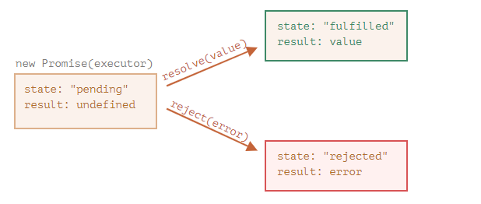
So the executor eventually moves promise to one of these states:

Slide 68
Here’s an example of a promise constructor and a simple executor function with “producing code” that takes time (via setTimeout):
let promise = new Promise(function(resolve, reject) {
// the function is executed automatically when the promise is constructed
// after 1 second signal that the job is done with the result "done"
setTimeout(() => resolve("done"), 1000);
});

Slide 69
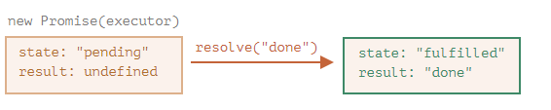
We can see two things by running the code above:
The executor is called automatically and immediately (by new Promise).
The executor receives two arguments: resolve and reject.
These functions are pre-defined by the JavaScript engine, so we don’t need to create them. We should only call one of them when ready.
After one second of “processing”, the executor calls resolve("done") to produce the result. This changes the state of the promise object:

Slide 70
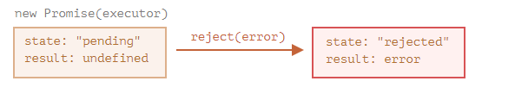
And now an example of the executor rejecting the promise with an error:
let promise = new Promise(function(resolve, reject) {
// after 1 second signal that the job is finished with an error
setTimeout(() => reject(new Error("Whoops!")), 1000);
});
The call to reject(...) moves the promise object to "rejected" state:
To summarize, the executor should perform a job (usually something that takes time) and then call resolve or reject to change the state of the corresponding promise object.

Slide 71
Consumers: then, catch
A Promise object serves as a link between the executor (the “producing code” or “singer”) and the consuming functions (the “fans”), which will receive the result or error.
Consuming functions can be registered (subscribed) using the methods .then and .catch.
then
The most important, fundamental one is .then.
The syntax is:
promise.then(
function(result) { /* handle a successful result */ },
function(error) { /* handle an error */ }
);
The first argument of .then is a function that runs when the promise is resolved and receives the result.
The second argument of .then is a function that runs when the promise is rejected and receives the error.

Slide 72
let promise = new Promise(function(resolve, reject) {
setTimeout(() => resolve("done!"), 1000);
});
// resolve runs the first function in .then
promise.then(
result => alert(result), // shows "done!" after 1 second
error => alert(error) // doesn't run
);

Slide 73
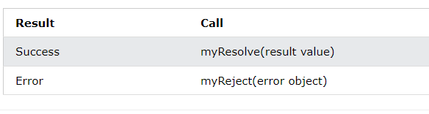
When the producing code obtains the result, it should call one of the two callbacks:

Slide 74
A Promise is in one of these states:
pending: initial state, neither fulfilled nor rejected.
fulfilled: meaning that the operation was completed successfully.
rejected: meaning that the operation failed.
A pending promise can either be fulfilled with a value or rejected with a reason (error).
When either of these options happens, the associated handlers queued up by a promise's then method are called.
If the promise has already been fulfilled or rejected when a corresponding handler is attached, the handler will be called, so there is no race condition between an asynchronous operation completing and its handlers being attached.

Slide 75
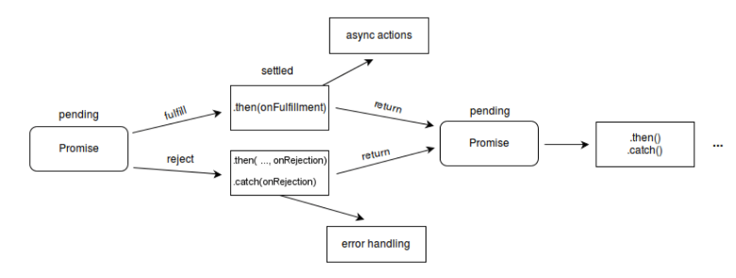

Slide 76
Promises in JavaScript represent processes that are already happening, which can be chained with callback functions.
If you are looking to lazily evaluate an expression, consider the arrow function with no arguments: f = () => expression to create the lazily-evaluated expression, and f() to evaluate.

Slide 77
The constructor syntax for a promise object is:
let promise = new Promise(function(resolve, reject) {
// executor (the producing code, "singer")
});
The function passed to new Promise is called the executor. When new Promise is created, the executor runs automatically. It contains the producing code which should eventually produce the result. In terms of the analogy above: the executor is the “singer”.
Its arguments resolve and reject are callbacks provided by JavaScript itself. Our code is only inside the executor.
When the executor obtains the result, be it soon or late, doesn’t matter, it should call one of these callbacks:
resolve(value) — if the job is finished successfully, with result value.
reject(error) — if an error has occurred, error is the error object.

Slide 78
So to summarize: the executor runs automatically and attempts to perform a job. When it is finished with the attempt, it calls resolve if it was successful or reject if there was an error.
The promise object returned by the new Promise constructor has these internal properties:
state — initially "pending", then changes to either "fulfilled" when resolve is called or "rejected" when reject is called.
result — initially undefined, then changes to value when resolve(value) called or error when reject(error) is called.

Slide 79
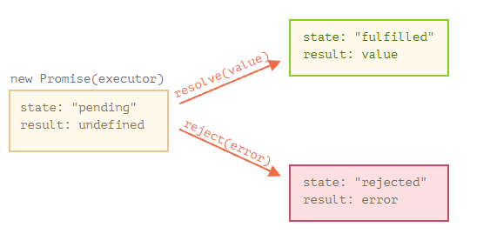
So the executor eventually moves promise to one of these states:

Slide 80
A Promise object serves as a link between the executor (the “producing code” or “singer”) and the consuming functions (the “fans”), which will receive the result or error.
Consuming functions can be registered (subscribed) using methods .then, .catch and .finally.
If we’re interested only in errors, then we can use null as the first argument: .then(null, errorHandlingFunction). Or we can use .catch(errorHandlingFunction), which is exactly the same:
let promise = new Promise((resolve, reject) => {
setTimeout(() => reject(new Error("Whoops!")), 1000);
});
// .catch(f) is the same as promise.then(null, f)
promise.catch(alert); // shows "Error: Whoops!" after 1 second
The call .catch(f) is a complete analog of .then(null, f), it’s just a shorthand.

Slide 81
Finally:
Just like there’s a finally clause in a regular try {...} catch {...}, there’s finally in promises.
The call .finally(f) is similar to .then(f, f) in the sense that f always runs when the promise is settled: be it resolve or reject.
finally is a good handler for performing cleanup, e.g. stopping our loading indicators, as they are not needed anymore, no matter what the outcome is.
new Promise((resolve, reject) => {
/* do something that takes time, and then call resolve/reject */
})
// runs when the promise is settled, doesn't matter successfully or not
.finally(() => stop loading indicator)
// so the loading indicator is always stopped before we process the result/error
.then(result => show result, err => show error)

Slide 82
Chained Promises
The methods promise.then(), promise.catch(), and promise.finally() are used to associate further action with a promise that becomes settled.
The .then() method takes up to two arguments; the first argument is a callback function for the resolved case of the promise, and the second argument is a callback function for the rejected case.
Each .then() returns a newly generated promise object, which can optionally be used for chaining; for example:
const myPromise = new Promise((resolve, reject) => {
setTimeout(() => {
resolve('foo');
}, 300);
});
myPromise
.then(handleResolvedA, handleRejectedA)
.then(handleResolvedB, handleRejectedB)
.then(handleResolvedC, handleRejectedC);

Slide 83
Variables:
A variable is a named space in the memory, which stores the values.
The names of the variable are known as identifiers.
There are some rules that you should keep in mind while naming an identifier.
These rules are as follows:
It can contain numbers and alphabets.
You cannot start the name of the variable with a number.
Keywords cannot be used as the name of the variable.
ES6 Variables
Identifiers do not contain spaces and special characters except the dollar ($) symbol and underscore (_).

Slide 84
Initialization of Variable
It is the process to store the value in the variable.
A variable can be initialized at any time before its use.
The ES6 syntax used the keyword var to declare a variable.
In ES5, we declare the variable like this:
var x //Declaration of a variable by using the var keyword
Valid type of syntax for variable declaration
Some variable declarations are considered to be valid are as follows:
var $example1=value
var example1=value
var _example$=value

Slide 85
JavaScript Dynamic Typing
JavaScript supports the concept of Dynamic Typing as similar to python, perl, ruby, etc.
It is a feature where you do not need to tell JavaScript about what type of value the variable will hold.
If the type of value of the variable gets changed during the execution of the program, then it gets triggered, and JavaScript automatically takes care of it.

Slide 86
ES6 and Variable Hoisting
Hoisting is the default behavior of JavaScript to move all declarations to the top of the current script, current function, or current scope.
It allows you to use the variable before its declaration.
JavaScript only hoists the variable declaration, not variable initialization.
For example:
JavaScript Declarations are Hoisted
x=10;
console.log(x);
var x;
O/P:
10

Slide 87
Instead of giving a declaration error, the above code will successfully execute and show the desired output.
It happens because of the hoisting concept. Let us see what happens when the code is in the compiling phase.
When the above code is in the compile phase, then it will be treated as:
In Compile phase
var x; // declaration of the variable will move on top.
x=10;
console.log(x);
Output:
10

Slide 88
JavaScript Initializations are not Hoisted
1. When you initialize the variable before using it
var x=100;
var y=200;
console.log(x+" "+y);
In compiling phase
var x;
var y;
x=100;
y=200;
console.log(x+" "+y);
Output:
100 200

Slide 89
II. When you initialize the variable after using it
var x=100;
console.log(x+" "+y);
var y=200;
Let us see what happens when this code is in the compile phase.
When this code is in compiling, then it will be treated as follows:
In Compiling phase
var x;
var y;
x=100;
console.log(x+" "+y);
y=200;
When you execute this code, you will get the following output in which the value of y is undefined.
Output:
100 undefined

Slide 90
JavaScript Variable Scope
There are two scopes in JavaScript that are global and local:
Global Scope: In the global scope, the variable can be accessed from any part of the JavaScript code.
Local Scope: In the local scope, the variable can be accessed within a function where it is declared.
Example:
The following example describes the Global and Local scope:
In this example, there are two variables one is outside the function (global scope), and the other is in the function (local scope).

Slide 91
var $var12 = 200;
function example() {
var $var12 = 300;
console.log("Inside example() function = "
+ $var12);
}
console.log("Outside example() function = "
+ $var12);
Outside example() function = 200
Inside example() function = 300

Slide 92
Var keyword:
In ES5, when you declare a variable using the var keyword, the scope of the variable is either global or local.
If you declare a variable outside of a function, the scope of the variable is global.
When you declare a variable inside a function, the scope of the variable is local.

Slide 93
Initialization of Variable
It is the process to store the value in the variable.
A variable can be initialized at any time before its use.
The ES6 syntax used the keyword var to declare a variable.
In ES5, we declare the variable like this:
var x //Declaration of a variable by using the var keyword
Valid type of syntax for variable declaration
Some variable declarations are considered to be valid are as follows:
var $example1=value
var example1=value
var _example$=value

Slide 94
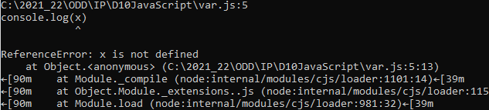
{
var x=10;
}
console.log(x);
Output:
10
function display()
{
var x=10;
}
console.log(x);
Output:
Error

Slide 95
In ES6, the variables are declared by:
Using let.
Using const.
let:
Any variable which is declared by using the let keyword is assigned the block scope.
Block scope is nothing but a section where the let variable gets declared whether it is a function{}, a block{}, or a global (script).
For example: var v/s let
By using var
var x = 100;
var x=200;
console.log(x);
When the code gets successfully executed, you will get the following output:
Output:
200

Slide 96
Let us try to re-write the above code by using the let keyword:
By using let
let x = 100;
let x=200;
console.log(x);
Output:
SyntaxError: Identifier 'x' has already been declared
When the code gets successfully executed, you will get an error that the identifier 'x' has already been declared.
So, any variable which is declared by using the let keyword is assigned the block scope.

Slide 97
let keyword
In ES5, when you declare a variable using the var keyword, the scope of the variable is either global or local.
If you declare a variable outside of a function, the scope of the variable is global.
When you declare a variable inside a function, the scope of the variable is local.
ES6 provides a new way of declaring a variable by using the let keyword.
The let keyword is similar to the var keyword, except that these variables are blocked-scope.

Slide 98
let variable_name;
In JavaScript, blocks are denoted by curly braces {} , for example, the if else, for, do while, while, try catch and so on:
if(condition) {
// inside a block
}
let x = 10;
if (x == 10) {
let x = 20;
console.log(x); // 20: reference x inside the block
}
console.log(x); // 10: reference at the beginning of the script

Slide 99
let x = 10;
if (x == 10)
{
let x = 20;
console.log(x); // 20: reference x inside the block
}
console.log(x); // 10: reference at the beginning of the script
//Output
20
10

Slide 100
JavaScript let and global object
When you declare a global variable using the var keyword, you add that variable to the property list of the global object.
In the case of the web browser, the global object is the window.
For example:
var a = 10;
console.log(window.a); // 10
However, when you use the let keyword to declare a variable, that variable is not attached to the global object as a property.
For example:
let b = 20;
console.log(window.b); // undefined

Slide 101
Redeclaration
The var keyword allows you to redeclare a variable without any issue:
var counter = 0;
var counter;
console.log(counter); // 0
However, redeclaring a variable using the let keyword will result in an error:
let counter = 0;
let counter;
console.log(counter);
Here’s the error message:
Uncaught SyntaxError: Identifier 'counter' has already been declared

Slide 102
{
console.log(counter); //
let counter = 10;
}
This code causes an error:
Uncaught ReferenceError: Cannot access 'counter' before initialization

Slide 103
Summary
Variables are declared using the let keyword are block-scoped, are not initialized to any value, and are not attached to the global object.
Redeclaring a variable using the let keyword will cause an error.

Slide 104
#1: Variable scopes
The var variables belong to the global scope when you define them outside a function. For example:
var counter;
In this example, the counter is a global variable.
It means that the counter variable is accessible by any functions.

Slide 105
The following example displays four numbers from 0 to 4 inside the loop and the number 5 outside the loop.
for (var i = 0; i < 5; i++) {
console.log("Inside the loop:", i);
}
console.log("Outside the loop:", i);
Code language: JavaScript (javascript)
Output:
Inside the loop: 0
Inside the loop: 1
Inside the loop: 2
Inside the loop: 3
Inside the loop: 4
Outside the loop: 5

Slide 106
The following example uses the let keyword instead of the var keyword:
for (let i = 0; i < 5; i++) {
console.log("Inside the loop:", i);
}
console.log("Outside the loop:", i);
Code language: JavaScript (javascript)
In this case, the code shows four numbers from 0 to 4 inside a loop and a reference error:
Inside the loop: 0
Inside the loop: 1
Inside the loop: 2
Inside the loop: 3
Inside the loop: 4
The error:
Uncaught ReferenceError: i is not defined

Slide 107
The var variables
In the creation phase, the JavaScript engine assigns storage spaces to var variables and immediately initializes them to undefined.
In the execution phase, the JavaScript engine assigns the var variables the values specified by the assignments if there are ones.
Otherwise, the var variables remain undefined.
The let variables
In the creation phase, the JavaScript engine assigns storage spaces to the let variables but does not initialize the variables.
Referencing uninitialized variables will cause a ReferenceError.
The let variables have the same execution phase as the var variables.

Slide 108
ES6 provides a new way of declaring a constant by using the const keyword. The const keyword creates a read-only reference to a value.
const CONSTANT_NAME = value;
By convention, the constant identifiers are in uppercase.
Like the let keyword, the const keyword declares blocked-scope variables.
However, the block-scoped variables declared by the const keyword can’t be reassigned.
The variables declared by the let keyword are mutable.
It means that you can change their values anytime you want as shown in the following example:
let a = 10;
a = 20;
a = a + 5;
console.log(a); // 25

Slide 109
However, variables created by the const keyword are “immutable”. In other words, you can’t reassign them to different values.
If you attempt to reassign a variable declared by the const keyword, you’ll get a TypeError like this:
const RATE = 0.1;
RATE = 0.2; // TypeError
Unlike the let keyword, you need to initialize the value to the variable declared by the const keyword.
The following example causes a SyntaxError due to missing the initializer in the const variable declaration:
const RED; // SyntaxError

Slide 110
JavaScript const and Objects
The const keyword ensures that the variable it creates is read-only.
However, it doesn’t mean that the actual value to which the const variable reference is immutable. For example:
const person = { age: 20 };
person.age = 30; // OK
console.log(person.age); // 30
Even though the person variable is a constant, you can change the value of its property.
However, you cannot reassign a different value to the person constant like this:
person = { age: 40 }; // TypeError

Slide 111
const:
ES6 gives a new way to declare a constant using the const keyword.
The keyword const creates a read-only reference to the value.
There are some properties of the const that are as follows:
Properties:
It cannot be reassigned a value.
It is block scoped.
A constant cannot be re-declared.
Constants must be initialized at the time of declaration.
For example:
const y=100
y=200 // It will result in an error
Output:
TypeError: Assignment to constant variable.
It will throw an error because the constant variables are immutable and cannot be reassigned a value.

Slide 112
Summary
The const keyword creates a read-only reference to a value.
The readonly reference cannot be reassigned but the value can be change.
The variables declared by the const keyword are blocked-scope and cannot be redeclared.

Slide 113
Scope:
Hoisting
Reassign the value:
To reassign a value is to reassign the value of a variable.
var | let | const
Variables declared with var are in the function scope. | Variables declared as let are in the block scope. | Variables declared as const are in the block scope.
var | let | const
Allowed | Not allowed | Not allowed
var | let | const
Allowed | Allowed | Not allowed

Slide 114
Redeclaration of the variable
The redeclaration of a variable means that you can declare the variable again.
var | let | const
Allowed | Not allowed | Not allowed

Slide 115
== is the abstract equality comparison operator and === is the strict equality comparison operator.
They both are ways to check for equality.
They check if something on the left is equal to something on the right.
The difference between these two is that the abstract equality operator doesn’t care about the data types, whereas the strict equality operator does.

Slide 116
console.log(2 == "2"); // true
console.log(0 == ""); // true
console.log(null == undefined); // true
console.log([] == ""); // true
// Triple Equals
console.log(2 === "2"); // false
console.log(0 === ""); // false
console.log(null === undefined); // false
console.log([] === ""); // false

Slide 117
Execution of Code in JavaScript
Let us try to understand how code executes in JavaScript by using an example:
var msg = "Hello World" //This line declares a variable.
console.log(msg); //This line print the value of the variable to the prompt. The console in it refers to the terminal window, and the log() is used to display the text on the screen.
Save this file by using .js extension as we are saving it with name Example.js. Then, right-click on this file, which is placed under the working files option in the project explorer window of the visual studio code, and select the 'open in terminal' option.
Type the following command in a terminal for executing the file:
node Example.js

Slide 118
The Strict Mode
The strict mode was introduced in ECMAScript 5 (the fifth edition of the ECMAScript specification).
You can use this strict mode in all of your programs. It will help you to write clean code, like preventing you from using undeclared variables.
Advantages of using strict mode:
There are several changes that strict mode makes to normal JavaScript semantics:
The strict mode prohibits some of the syntaxes, which is likely to be defined within the future versions of ECMAScript.
Strict mode removes some of the JavaScript silent errors by changing them to throw errors.
The strict mode also fixes the mistakes, which makes it difficult for the JavaScript engines to perform optimizations, so the strict mode sometimes makes to run faster compared to the identical mode.

Slide 119
"use strict";
function example() {
x= 89; // It will also cause an error because x is not declared
}
example();

Slide 120
ES6 Environment Setup
JavaScript can run on any host, any operating system, and on any browser.
To start experimenting with JavaScript, you have to download the latest version of the Node.
Node is a platform that runs on the V8 JavaScript engine (It is a JavaScript engine that is responsible for running the JavaScript code) of Google.
It helps you to create scalable and fast applications by using pure JavaScript.

Slide 121
You will require the following for writing and testing of a JavaScript program standard:
Text Editor
Text Editor is a computer program that edits plain text.
It is used to write the source code. Some of the text editors include notepad or notepad++ for Microsoft Windows.
UNIX or Unix-like operating systems use the Pico editor but may also use the VI and Emacs editor.

Slide 122
Installing the Node.js
The Node.js is an open-source server-side environment that is free and can run on multiple platforms such as Windows, UNIX, Linux, etc.
It uses the JavaScript on the server.
It uses the Google V8 JavaScript engine for executing the code.
It uses the asynchronous programming (It is a design pattern that ensures the execution of non-blocking code).

Slide 123
JavaScript Collections – Map and Set
An object is created with curly braces {…} and a list of properties.
A property is a key-value pair where the key must be a string and the value can be of any type.
On the other hand, arrays are an ordered collection that can hold data of any type.
In JavaScript, arrays are created with square brackets [...] and allow duplicate elements.

Slide 124
Until ES6 (ECMAScript 2015), JavaScript objects and arrays were the most important data structures to handle collections of data.
Even so, a combination of objects and arrays was able to handle data in many scenarios.
However, there were a few shortcomings,
Object keys can only be of type string.
Objects don't maintain the order of the elements inserted into them.
Objects lack some useful methods, which makes them difficult to use in some situations.
For example, you can't compute the size (length) of an object easily.
Also, enumerating an object is not that straightforward.
Arrays are collections of elements that allow duplicates.
Supporting arrays that only have distinct elements requires extra logic and code.

Slide 125
ES6 introduces two new data structures: Maps and Sets.
Maps − This data structure enables mapping a key to a value.
Sets − Sets are similar to arrays. However, sets do not encourage duplicates.
Maps
The Map object is a simple key/value pair. Keys and values in a map may be primitive or objects.
Following is the syntax for the same.
new Map([iterable])
The parameter iterable represents any iterable object whose elements comprise of a key/value pair.
Maps are ordered, i.e. they traverse the elements in the order of their insertion

Slide 126
With the introduction of ES6, we got two new data structures that address the shortcomings mentioned above: Map and Set.
Map in JavaScript
Map is a collection of key-value pairs where the key can be of any type. Map remembers the original order in which the elements were added to it, which means data can be retrieved in the same order it was inserted in.
In other words, Map has characteristics of both Object and Array:
Like an object, it supports the key-value pair structure.
Like an array, it remembers the insertion order.

Slide 127
How to Create and Initialize a Map in JavaScript
A new Map can be created like this:
const map = new Map();
Which returns an empty Map:
Map(0) {}
Another way of creating a Map is with initial values.
Here's how to create a Map with three key-value pairs:

Slide 128
Another way of creating a Map is with initial values. Here's how to create a Map with three key-value pairs:
const freeCodeCampBlog = new Map([
['name', 'freeCodeCamp'],
['type', 'blog'],
['writer', 'Tapas Adhikary'],
]);
Which returns a Map with three elements:
Map(3) {"name" => "freeCodeCamp", "type" => "blog", "writer" => "Tapas Adhikary"}

Slide 129
How to Add values to a Map in JavaScript
To add value to a Map, use the set(key, value) method.
The set(key, value) method takes two parameters, key and value, where the key and value can be of any type, a primitive (boolean, string, number, etc.) or an object:
// create a map
const map = new Map();
// Add values to the map
map.set('name', 'freeCodeCamp');
map.set('type', 'blog');
map.set('writer', 'Tapas Adhikary');
Output:
Map(3) {"name" => "freeCodeCamp", "type" => "blog", "writer" => "Tapas Adhikary"}

Slide 130
Please note, if you use the same key to add a value to a Map multiple times, it'll always replace the previous value:
// Add a different writer
map.set('writer', 'Someone else!');
So the output would be:
Map(3)
{"name" => "freeCodeCamp", "type" => "blog", "writer" => "Someone else!"}
How to Get values from a Map in JavaScript
To get a value from a Map, use the get(key) method:
map.get('name'); // returns freeCodeCamp

Slide 131
All About Map Keys in JavaScript
Map keys can be of any type, a primitive, or an object. This is one of the major differences between Map and regular JavaScript objects where the key can only be a string:
// create a Map
const funMap = new Map();
funMap.set(360, 'My House Number'); // number as key
funMap.set(true, 'I write blogs!'); // boolean as key
let obj = {'name': 'tapas'}
funMap.set(obj, true); // object as key
console.log(funMap);
Here is the output:
Map(3)
{
360 => "My House Number",
true => "I write blogs!",
{…} => true
}

Slide 132
Map Properties
This property returns the number of key/value pairs in the Map object.
Syntax
Map.size
Example
var myMap = new Map();
myMap.set("J", "john");
myMap.set("M", "mary");
myMap.set("T", "tom");
console.log(myMap.size);
Output
3

Slide 133
Understanding basic Map operations
The set() function sets the value for the key in the Map object.
The set() function takes two parameters namely, the key and its value. This function returns the Map object.
The has() function returns a boolean value indicating whether the specified key is found in the Map object.
This function takes a key as parameter.
var map = new Map();
map.set('name','Tutorial Point');
map.get('name'); // Tutorial point

Slide 134
var map = new Map();
map.set(1,true);
console.log(map.has("1")); //false
map.set("1",true);
console.log(map.has("1")); //true
Output
false
true

Slide 135
The set() method is also chainable. Consider the following example.
var roles = new Map();
roles.set('r1', 'User')
.set('r2', 'Guest')
.set('r3', 'Admin');
console.log(roles.has('r1'))
Output
True

Slide 136
The get() function is used to retrieve the value corresponding to the specified key.
The Map constructor can also be passed an array.
Moreover, map also supports the use of spread operator to represent an array.
Example
var roles = new Map([
['r1', 'User'],
['r2', 'Guest'],
['r3', 'Admin'],
]);
console.log(roles.get('r2'))
The following output is displayed on successful execution of the above code.
Guest

Slide 137
Sets
A set is an ES6 data structure.
It is similar to an array with an exception that it cannot contain duplicates.
In other words, it lets you store unique values.
Sets support both primitive values and object references.
Just like maps, sets are also ordered, i.e. elements are iterated in their insertion order.

Slide 138
Set in JavaScript
A Set is a collection of unique elements that can be of any type.
Set is also an ordered collection of elements, which means that elements will be retrieved in the same order that they were inserted in.
A Set in JavaScript behaves the same way as a mathematical set.
How to Create and Initialize a Set in JavaScript
A new Set can be created like this:
const set = new Set();
console.log(set);
And the output will be an empty Set:
Set(0) {}

Slide 139
Here's how to create a Set with some initial values:
const fruteSet = new Set(['🍉', '🍎', '🍈', '🍏']);
console.log(fruteSet);
Output:
Set(4) {"🍉", "🍎", "🍈", "🍏"}

Slide 140
Set Properties and Methods in JavaScript
Set has methods to add an element to it, delete elements from it, check if an element exists in it, and to clear it completely:
Use the size property to know the size of the Set. It returns the number of elements in it:
Use the add(element) method to add an element to the Set:
set.size
// Create a set - saladSet
const saladSet = new Set();
// Add some vegetables to it
saladSet.add('🍅'); // tomato
saladSet.add('🥑'); // avocado
saladSet.add('🥕'); // carrot
saladSet.add('🥒'); // cucumber
console.log(saladSet);
// Output
// Set(4) {"🍅", "🥑", "🥕", "🥒"}

Slide 141
Set is a collection of unique elements:
saladSet.add('🥒');
console.log(saladSet);
The output is the same as before – nothing got added to the saladSet.
Use the has(element) method to search if we have a carrot (🥕) or broccoli (🥦) in the Set:
Use the delete(element) method to remove the avocado(🥑) from the Set:
// The salad has a🥕, so returns true
console.log('Does the salad have a carrot?', saladSet.has('🥕'));
// The salad doesn't have a🥦, so returns false
console.log('Does the salad have broccoli?', saladSet.has('🥦'));
saladSet.delete('🥑');
console.log('I do not like 🥑, remove from the salad:', saladSet);

Slide 142
How to Iterate Over a Set in JavaScript
Set has a method called values() which returns a SetIterator to get all its values:
// Create a Set
const houseNos = new Set([360, 567, 101]);
// Get the SetIterator using the `values()` method
console.log(houseNos.values());
Output:
SetIterator {360, 567, 101}
We can use a forEach or for-of loop on this to retrieve the values.
Interestingly, JavaScript tries to make Set compatible with Map. That's why we find two of the same methods as Map, keys() and entries().
As Set doesn't have keys, the keys() method returns a SetIterator to retrieve its values:
console.log(houseNos.keys());
// Output
// console.log(houseNos.keys());

Slide 143
With Map, the entries() method returns an iterator to retrieve key-value pairs.
Again there are no keys in a Set, so entries() returns a SetIterator to retrieve the value-value pairs:
console.log(houseNos.entries());

Slide 144
How to Enumerate over a Set in JavaScript
We can enumerate over a Set using forEach and for-of loops:
// with forEach
houseNos.forEach((value) => {
console.log(value);
});
// with for-of
for(const value of houseNos) {
console.log(value);
}
The output of both is:
360
567
101

Slide 145
This method appends a new element with the given value to the Set object.
Syntax
mySet.add(value);
Parameters
Value − item to add to the list.
Return Value
Set Object.
Example
var set = new Set();
set.add(10);
set.add(10); // duplicate not added
set.add(10); // duplicate not added
set.add(20);
set.add(30);
console.log(set.size);
Output
3

Slide 146
ES6 Arrays
Array in JavaScript
is an object which is used to represent a collection of similar type of elements. It allows you to store more than one value or a group of values in a single variable name.
Arrays are used for storing the collections of values in chronological order. An array is the collection of homogeneous elements, or we can say that array is the collection of values of same data-type.

Slide 147
Features of an Array
An array declaration allocates sequential memory blocks.
Arrays are static. This means that an array once initialized cannot be resized.
Each memory block represents an array element.
Array elements are identified by a unique integer called as the subscript/index of the element.
Arrays too, like variables, should be declared before they are used.
Array initialization refers to populating the array elements.
Array element values can be updated or modified but cannot be deleted.

Slide 148
Accessing Array Elements
The array name followed by the subscript is used to refer to an array element.
Following is the syntax for the same.
array_name[subscript]
Example: Simple Array
var alphas;
alphas = ["1","2","3","4"]
console.log(alphas[0]);
console.log(alphas[1]);

Slide 149
Array Object
An array can also be created using the Array object. The Array constructor can be passed as −
A numeric value that represents the size of the array or.
A list of comma separated values.
The following Examples create an array using this method.
Example
var arr_names = new Array(4)
for(var i = 0;i<arr_names.length;i++) {
arr_names[i] = i * 2
console.log(arr_names[i])
}

Slide 150
The following output is displayed on successful execution of the above code.
0
2
4
6

Slide 151
Example: Array Constructor Accepts Comma-separated Values
var names = new Array("Mary","Tom","Jack","Jill")
for(var i = 0;i<names.length;i++) {
console.log(names[i])
}
The following output is displayed on successful execution of the above code.
Mary
Tom
Jack
Jill

Slide 152
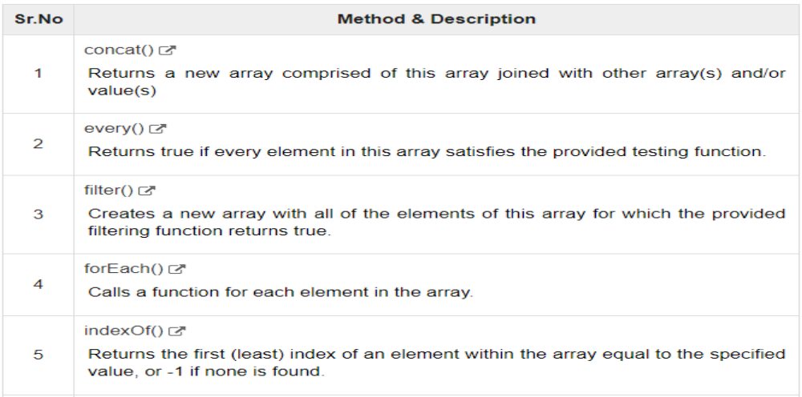
Array Methods

Slide 153
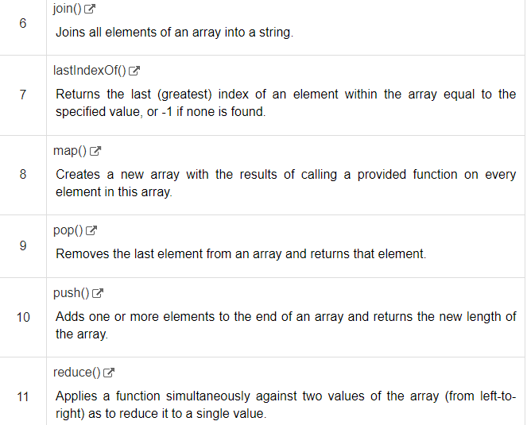

Slide 154
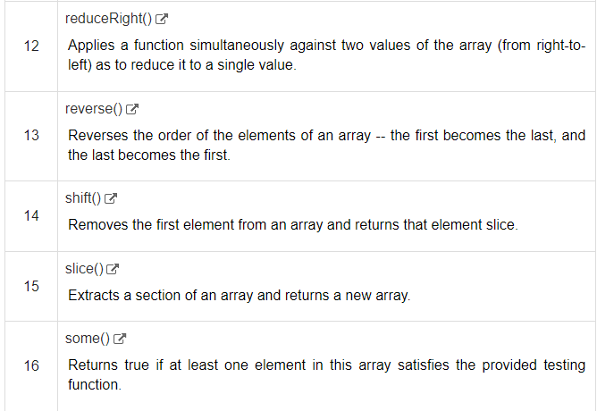

Slide 155
slice() method extracts a section of an array and returns a new array.
Syntax
array.slice( begin [,end] );
Parameter Details:
begin − Zero-based index at which to begin extraction. As a negative index, start indicates an offset from the end of the sequence.
end − Zero-based index at which to end extraction.
Return Value
Returns the extracted array based on the passed parameters.
Example
var arr = ["orange", "mango", "banana", "sugar", "tea"];
console.log("arr.slice( 1, 2) : " + arr.slice( 1, 2) );
console.log("arr.slice( 1, 3) : " + arr.slice( 1, 3) );
Output
arr.slice( 1, 2) : mango
arr.slice( 1, 3) : mango,banana

Slide 156
forEach() method calls a function for each element in the array.
Syntax
array.forEach(callback[, thisObject]);
Parameters
callback − Function to test for each element.
thisObject − Object to use as this when executing callback.
Return Value
Returns created array.

Slide 157
Example: forEach()
var nums = new Array(12,13,14,15)
console.log("Printing original array......")
nums.forEach(function(val,index) {
console.log(val)
})
nums.reverse() //reverses the array element
console.log("Printing Reversed array....")
nums.forEach(function(val,index){
console.log(val)
})

Slide 158
Output
Printing Original Array….
12
13
14
15
Printing Reversed array…
15
14
13
1

Slide 159
Introduction to the JavaScript for...of loop
ES6 introduced a new construct for...of that creates a loop that iterates over iterable objects such as:
Built-in Array, String, Map, Set, …
The following illustrates the syntax of the for...of:
for (variable of iterable) {
// statements
}
variable
In each iteration, a property of the iterable object is assigned to the variable. You can use var, let, or const to declare the variable.
iterable
The iterable is an object whose iterable properties are iterated.

Slide 160
JavaScript for of loop examples
Let’s take a look at some examples of using the for...of loop.
1) Iterating over arrays
The following example shows how to use the for...of to iterate over elements of an array:
let scores = [80, 90, 70];
for (let score of scores) {
score = score + 5;
console.log(score);
}
Output:
85
95
75

Slide 161
In this example, the for...of iterates over every element of the scores array.
It assigns every element of the scores array to the variable score in each iteration.
If you don’t change variable inside the loop, you should use the const keyword instead of the let keyword as follows:
let scores = [80, 90, 70];
for (const score of scores)
{
console.log(score);
}

Slide 162
In this example, the for...of iterates over every element of the scores array.
It assigns every element of the scores array to the variable score in each iteration.
If you don’t change variable inside the loop, you should use the const keyword instead of the let keyword as follows:
let scores = [80, 90, 70];
for (const score of scores) {
console.log(score);
}
Output:
80
90
70

Slide 163
To access the index of the array elements inside the loop, you can use the for...lop statement with the entries() method of the array.
The array.entries() method returns a pair of [index, element] in each iteration. For example:
let colors = ['Red', 'Green', 'Blue'];
for (const [index, color] of colors.entries())
{
console.log(`${color} is at index ${index}`);
}
Output:
Red is at index 0
Green is at index 1
Blue is at index 2

Slide 164
In-place object destructuring with for…of
Consider the following example:
const ratings = [
{user: 'John',score: 3},
{user: 'Jane',score: 4},
{user: 'David',score: 5},
{user: 'Peter',score: 2},
];
let sum = 0;
for (const {score} of ratings) {
sum += score;
}
console.log(`Total scores: ${sum}`); // 14
Output:
Total scores: 14

Slide 165
The ratings is an array of objects.
Each object has two properties user and score.
The for...of iterate over the ratings array and calculate the total scores of all objects.
The expression const {score} of ratings uses object destructing to assign the score property of the current iterated element to the score variable.

Slide 166
3) Iterating over strings
The following example uses the for...of loop to iterate over characters of a string.
let str = 'abc';
for (let c of str)
{
console.log(c);
}
Output:
a
b
c

Slide 167
3) Iterating over Map objects
The following example illustrates how to use the for...of statement to iterate over a Map object.
let colors = new Map();
colors.set('red', '#ff0000');
colors.set('green', '#00ff00');
colors.set('blue', '#0000ff');
for (let color of colors)
{
console.log(color);
}
Output:
[ 'red', '#ff0000' ]
[ 'green', '#00ff00' ]
[ 'blue', '#0000ff' ]

Slide 168
4) Iterating over Set objects
The following example shows how to iterate over a Set object using the for...of loop:
let nums = new Set([1, 2, 3]);
for (let num of nums) {
console.log(num);
}

Slide 169
for...of vs. for...in
The for...in iterates over all enumerable properties of an object.
It doesn’t iterate over a collection such as Array, Map or Set.
Unlike the for...in loop, the for...of iterates a collection, rather than an object.
In fact, the for...of iterates over elements of any collection that has the [Symbol.iterator] property.
The following example illustrates the differences between for...of and for...in:
for (let i of numbers)
{
console.log(i);
}

Slide 170
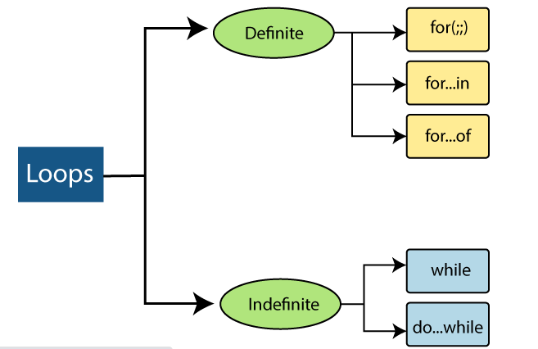
ES6 Loops
Looping statements in the programming languages help to execute the set of instructions/functions repeatedly while a condition evaluates to true.
Loops are an ideal way to perform the execution of certain conditions repeatedly. In a loop, the repetition is termed as iteration.
You can see the classification of loops in the following figure:

Slide 171
Definite Loops
A definite loop has a definite/fixed number of iterations. In ES6 there are three types of definite loops that are listed below:
Definite Loop | Description
for( ; ; ) Loop | It executes the block of code for a definite number of times.
for…in Loop | It iterates through the properties of the object.
for…of loop | Unlike object literals, it iterates the iterables (arrays, string, etc.).

Slide 172
The for ( ; ; ) loop
The for ( ; ; ) loop is used to iterate a part of the program multiple times.
If you have a fixed number of iterations, then it is always recommended to use 'for' loop.
Syntax
for(initialization;condition;incr/decr){
//statement or code to be executed
}

Slide 173
var i;
for(i=1;i<=10;i++)
{
console.log("2 x "+ i +" =", 2*i);
}
for loop having multiple expressions
You can combine the multiple assignments and final expressions in a single for loop by using the comma (, ) operator.
Let us try to print the Fibonacci series by using the single for loop.
"use strict"
for(let temp, a = 0, b = 1; b<40; temp = a, a = b, b = a + temp)
console.log(b);

Slide 174
for(;;)
{
console.log("infinitive loop"); // It will print infinite times
}

Slide 175
The for…in loop
The for…in loop is similar to for loop, which iterates through the properties of an object, i.e., when you require to visit the properties or keys of the object, then you can use for…in loop.
It is a better choice when you are working with objects or dictionaries where the order of index is not essential.
Syntax
for (variable_name in object_name) //Here in is the keyword
{
// statement or block to execute
}

Slide 176
function Mobile(model_no){
this.Model = model_no;
this.Color = 'White';
this.RAM = '4GB';
}
var Samsung = new Mobile("Galaxy");
for(var props in Samsung)
{
console.log(props+ " : " +Samsung[props]);
}

Slide 177
The for…of loop
Unlike the object literals, this loop is used to iterate the iterables (arrays, string, etc.).
Syntax
for(variable_name of object_name) // Here of is a keyword
{
//statement or block to execute
}
In every iteration, one property from the iterables gets assigned to the variable_name, and the loop continues till the end of the iteration.

Slide 178
var fruits = ['Apple', 'Banana', 'Mango', 'Orange'];
for(let value of fruits)
{
console.log(value);
}

Slide 179
while Loop | It executes the instructions each time till the defined condition evaluates to true.
do…while Loop | It is similar to the while loop, but the key difference is that the do…while loop executes the loop at once irrespective of the terminator condition.

Slide 180
The while loop
A while loop is a control flow statement that allows the repeated execution of code based on the given Boolean condition.
It consists of a block of code and an expression/condition.
The while loop checks the expression/condition before the execution of block.
Control structure is often known as a pre-test loop.
Syntax
while (condition)
{
statements;
}

Slide 181
var y = 0;
while (y < 4) {
console.log(y);
y++;
}
Output
0
1
2
3

Slide 182
The do…while loop
It is a control flow statement that executes a block of code at least once, and then it will depend upon the condition whether or not the loop executes the block repeatedly.
The do…while loop checks the condition after the execution of the block, that's why this control structure is also known as the post-test loop.
It is also possible that the condition always evaluates to true, which will create an infinite loop.
Syntax
do
{
// block of statements to be executed;
}
while (expression);

Slide 183
var count = 6, fact = 1;
do {
fact = fact * count--;
} while (count > 0);
console.log(fact);
Output
720

Slide 184
The Loop control statements
The loop control statements are used for interrupting or control the flow of the execution.
These statements change the execution from its normal sequence.
JavaScript provides you the full control to handle the loops and switch statements.
There may be some circumstances when you require to come out from the loop without reaching its bottom.
There may also be some situations when you need to skip the part of the code and start the further iterations of the loop.
So, for handling such situations in JavaScript, we have a break and continue statements.

Slide 185
Loop control statements:
The break statement
The break statement is used to bring the control of the program out from the loop.
The continue statement
It skips the subsequent statements of the current iteration and brings control of the program to the beginning of the loop.

Slide 186
var n = 0;
while(n<=5)
{
n++;
if(n==3)
{
continue;
}
console.log("n = "+n);
}

Slide 187
Use of Labels for controlling the flow
A label is nothing but an identifier followed by a colon (:), and it applied on a block of code or a statement.
You can use the label with a break and continue to control the flow.
You cannot use the line breaks in between the break and continue statement and its label name.
Also, there should not be any statement in between the label name and an associated loop.
The syntax for defining the label
labelname:
Statement
labelname: Any identifier of JavaScript, which is not a reserved word.
Statement: It is a JavaScript statement.

Slide 188
Label | Description
Label with the break statement | It is used to exit from the loop or from the switch statement without using a label reference, but with label reference, it is used to jump out from any code block.
Label with continue statement | It is used to skip one iteration of the loop with or without using the label reference.

Slide 189
var x, y;
loop1: //The first for statement is labeled as "loop1."
for (x = 1; x < 4; x++) {
loop2: //The second for statement is labelled as "loop2"
for (y = 1; y < 4; y++) {
if (x === 2 && y === 2) {
break loop1;
}
console.log('x = ' + x + ', y = ' + y);
}
}

Slide 190
Output
x = 1, y = 1
x = 1, y = 2
x = 1, y = 3
x = 2, y = 1

